Slide 1
Historic Preservation Commission
June 28, 2018

Slide 2
Historic Rehabilitation Program Overview
Presentation

Slide 3
Historic Rehab Program
Established in August 2016 to replace Paint Rebate Program
Eligible projects include:
Historic window repair
Wood door refinishing
Painting wood or stucco exteriors
Front porch repair
Exterior chimney repair

Slide 4
Historic Rehab Program
Limited to local historic districts and local landmarks
Grant or loan for 50% of project up to $5,000
Applicants submit plans and at least two reasonable bids
Approved funding:
FY17- $47,500 – 11 projects total
FY18- $6,050 (plus $5,930 tentative funding)

Slide 5
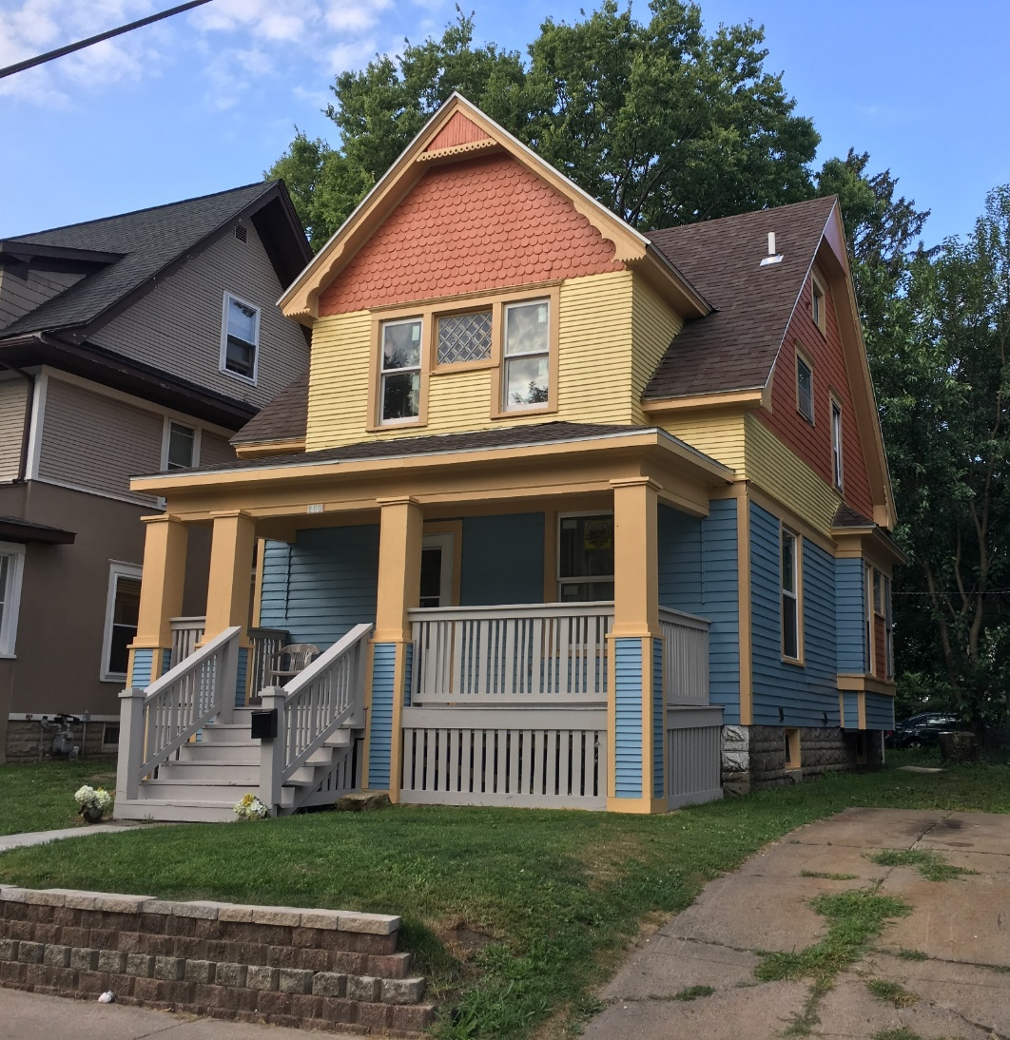
Historic Rehab Program

Slide 6
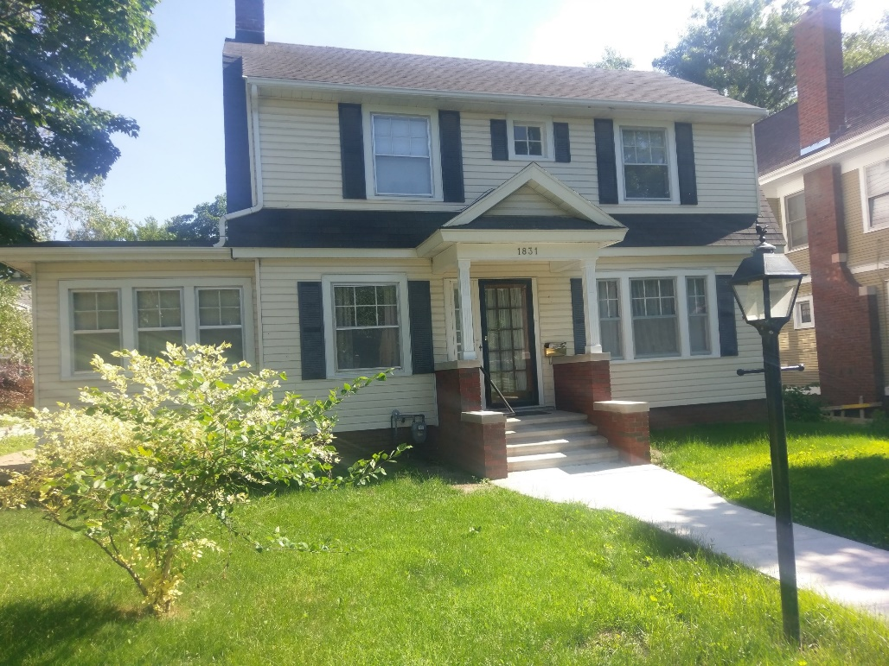
Historic Rehab Program

Slide 7
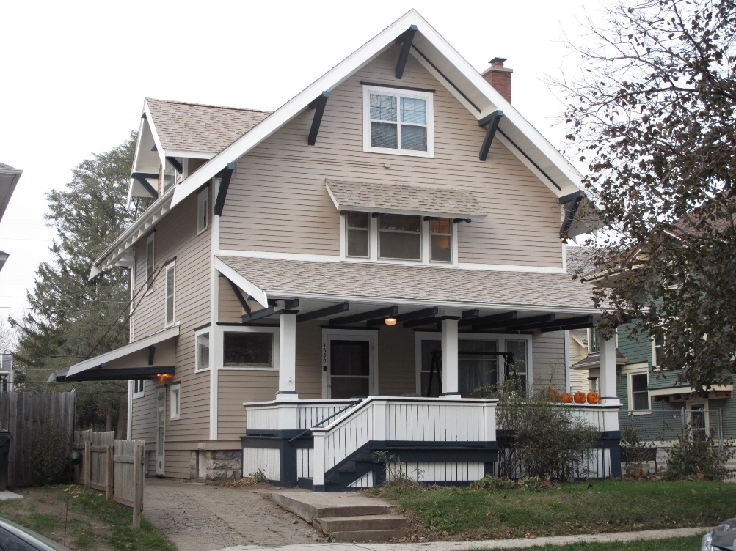
Historic Rehab Program

Slide 8
Proactive Preservation
Presentation

Slide 9
1708 2nd Ave SE
Certificate of Appropriateness

Slide 10
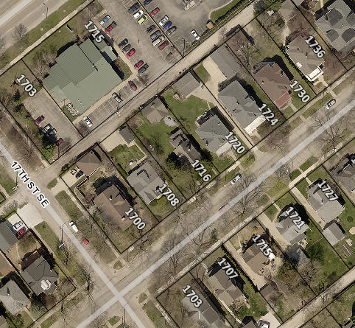
Project Description
Tuckpointing the chimney with matching mortar color and repairing cap and flashing area with commercial grade tar/sealer
Primary structure built in 1933
Contributing structure to the 2nd and 3rd Avenue Local Historic District

Slide 11
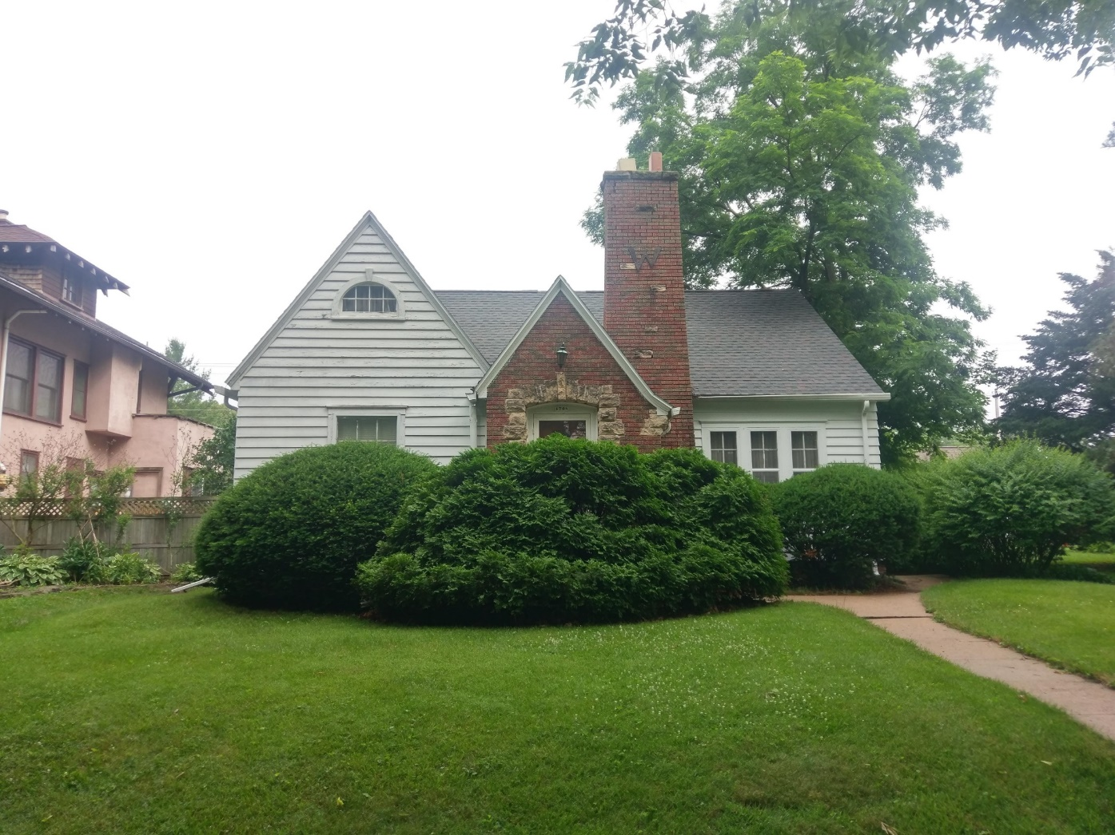
1708 2nd Ave SE

Slide 12
Historic District Guidelines – Chimneys
Recommended:
Replacing any broken, spalled, or missing bricks with the same size and color
Flue caps of clay, stone, concrete, or black metal
Repairing a deteriorated chimney with like material
Replacing a chimney with bricks similar to the original color and size
Not Recommended:
Replacing a chimney visible from the street
Demolishing a chimney

Slide 13
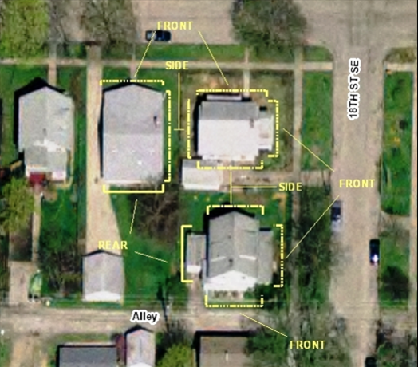
Guideline Prioritization
Those features that face the street or face the alley where it intersects the street. Buildings on corner lots, lots which are located at the intersection of two streets, or at the intersection of a street and an alley, are considered to have two street faces.
Features on sides of buildings that are visible from the street but don’t directly face the street.
Other exterior features not in direct view from the street such as at the rear of buildings.

Slide 14
Criteria for Decision
If any defining features of the building or structure as indicated, but not limited to those included on the Site Inventory Form(s) are proposed to be modified as a result of the proposal indicated on the application for Certificate.
If the proposal is consistent with the Guidelines for Cedar Rapids Historic Districts and/or the most recent edition of the Secretary of Interior's Standards for Rehabilitating Historic Buildings.
If the proposal mitigates adverse effects on the aesthetic, historic, or architectural significance of either the building or structure or of the local historic district or local historic landmark.

Slide 15
Recommendation
Staff recommends approval of project
The chimney’s appearance will not be altered by this project
Guidelines recommend keeping flashing in good repair, maintenance of masonry, and a properly functioning cap

Slide 16
Actions
Approve as submitted; or
Approve with modifications agreeable to the applicant; or
Deny the application; or
Request additional information.

Slide 17
502 A Ave NW
Demolition Review

Slide 18
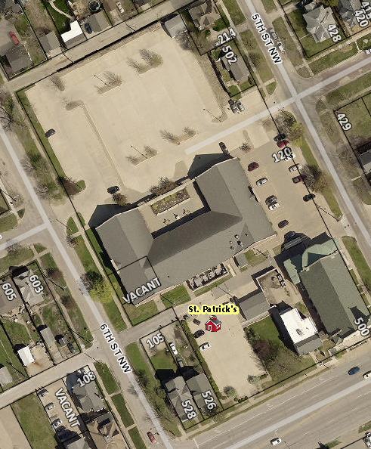
502 A Ave NW
Primary structure built in 1890
Identified as ineligible for individual listing or listing as part of a historic district
Architectural Reconnaissance Survey for St. Patrick’s Neighborhood in Cedar Rapids, 2009
Immediate Release

Slide 19
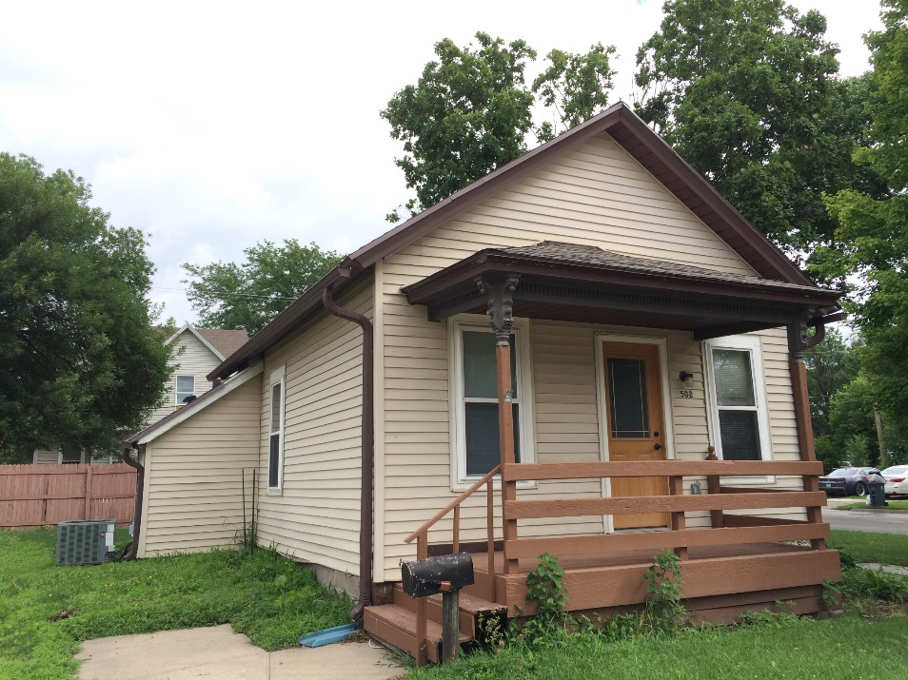
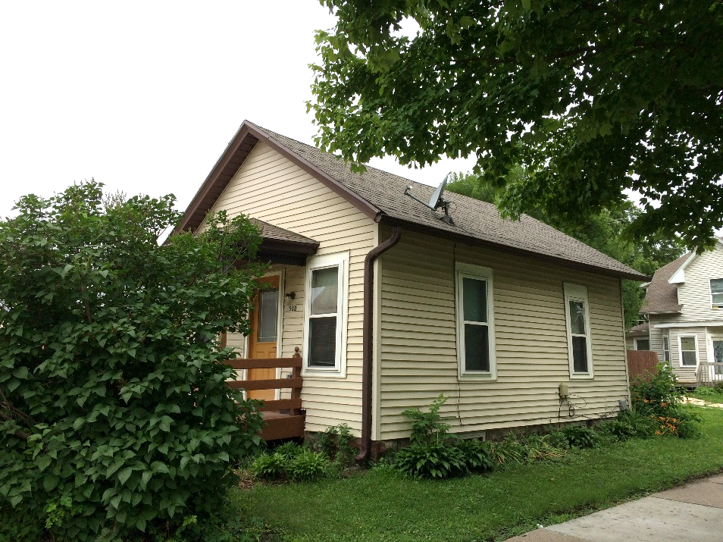
502 A Ave NW

Slide 20
502 A Ave NW
Poor candidate for local landmarking or inclusion in a historic district.
No evidence to corroborate historical significance.

Slide 21
1. Determination of Historic Significance
2a. Not Historically Significant
2b. Historically Significant
Release Property
60-day hold if HPC wishes to explore options (e.g. photo doc) with property owner
Release property if HPC does not wish to explore options

Slide 22
18.02(T) Cedar Rapids Municipal Code – Historic Significance:
1. Associated with events that have made a significant contribution to the broad patterns of our history; or
2. Associated with the lives of significant persons in our past; or
3. Embodies the distinctive characteristics of a type, period, or method of construction, or represents the work of a master, or possesses high artistic values, or represents a significant and distinguishable entity whose components may lack individual distinction; or
4. Yielded, or may be likely to yield, information important in history or prehistory.

Slide 23
4044 F Ave NW #2
Demolition Review

Slide 24
4044 F Ave NW #2
Primary structure built in 1919
Not included in a survey area or recommended for survey
One of two structures on the parcel
Condition is poor, per city assessor

Slide 25
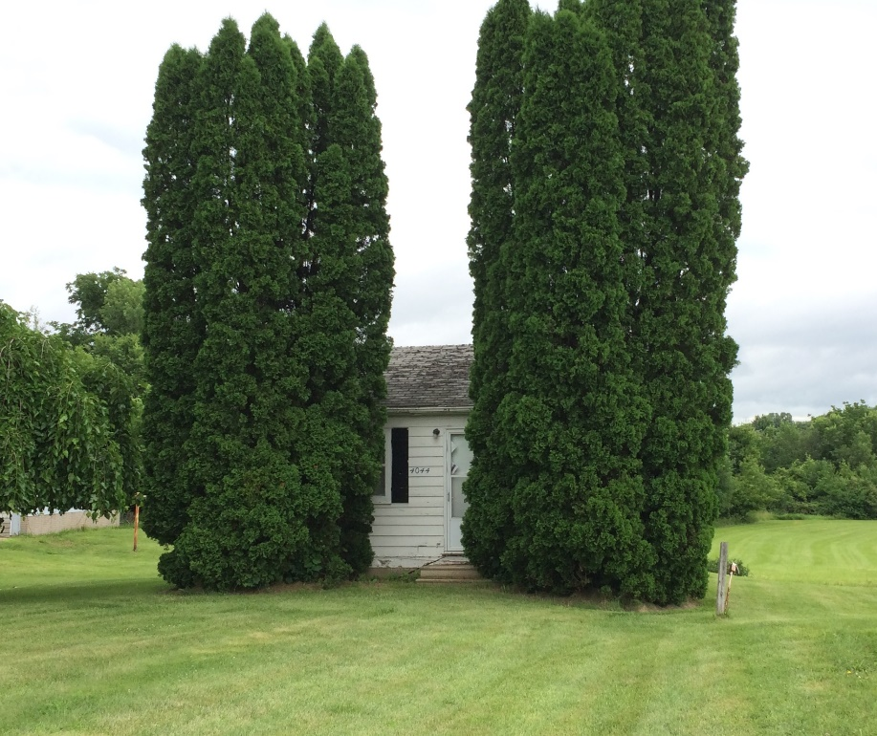
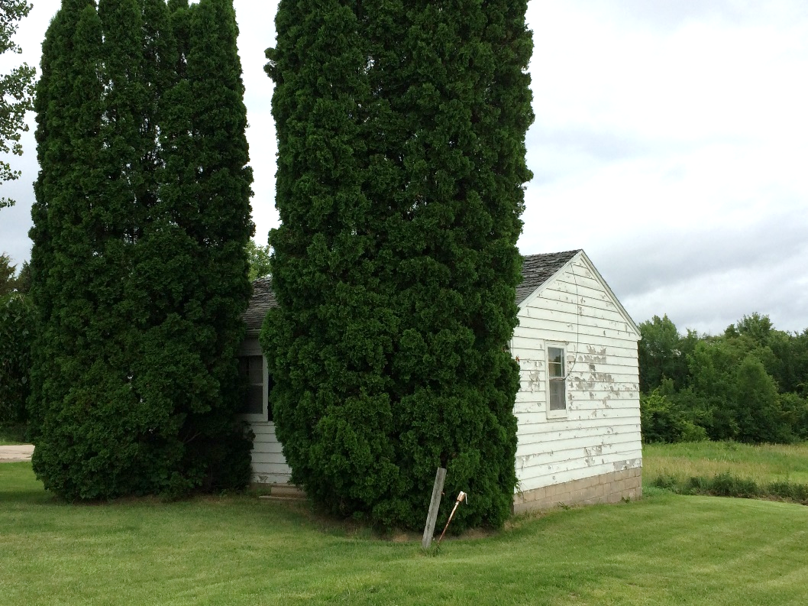
4044 F Ave NW #2

Slide 26
4044 F Ave NW #2
Structure is in poor condition, as per city assessor
Poor candidate for local landmarking
No evidence to corroborate historical significance

Slide 27
1. Determination of Historic Significance
2a. Not Historically Significant
2b. Historically Significant
Release Property
60-day hold if HPC wishes to explore options (e.g. photo doc) with property owner
Release property if HPC does not wish to explore options

Slide 28
18.02(T) Cedar Rapids Municipal Code – Historic Significance:
1. Associated with events that have made a significant contribution to the broad patterns of our history; or
2. Associated with the lives of significant persons in our past; or
3. Embodies the distinctive characteristics of a type, period, or method of construction, or represents the work of a master, or possesses high artistic values, or represents a significant and distinguishable entity whose components may lack individual distinction; or
4. Yielded, or may be likely to yield, information important in history or prehistory.

Slide 29
1545 2nd Ave SE
Historic Rehab Program – Funding Consideration

Slide 30
Project Description
Painting the wood siding on the exterior of the home, including prep work
Bid 1: S&R Painting and Staining—$10,915
Bid 2: CorSco, LLC—$31,250

Slide 31
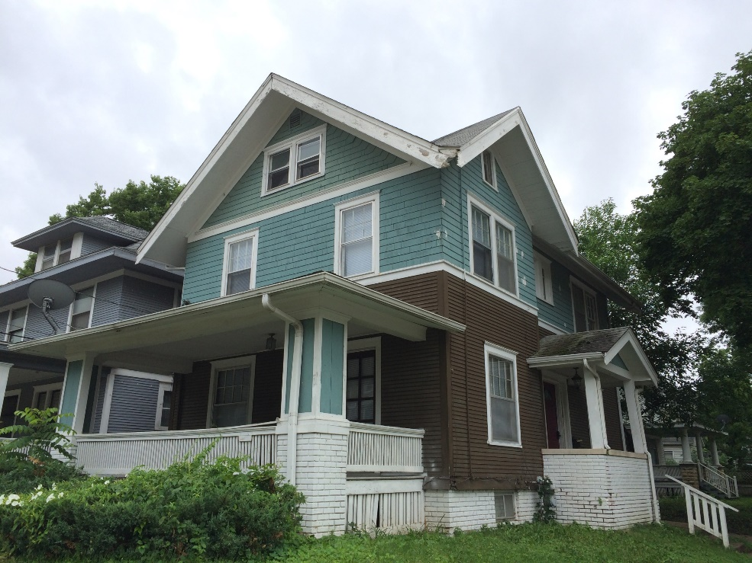
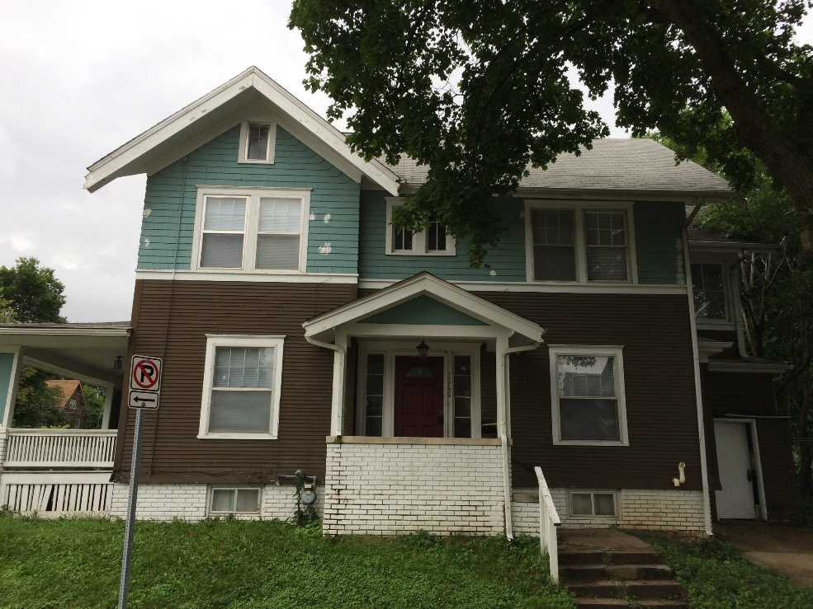
1545 2nd Ave SE

Slide 32
Recommendation
Staff recommends approval of funding for the project:
Project is eligible for the program; and
Consistent with District Guidelines; and
Not removing architectural detailing; and
No impact on defining features; and
Keeps the structure in use and good repair.

Slide 33
1708 2nd Ave SE
Historic Rehab Program—Consideration of Funding

Slide 34
Project Description
Tuckpointing the chimney with matching mortar color and repairing cap and flashing area with commercial grade tar/sealer
Bid 1: Steve Moyle—$1,550.00
Bid 2: Pesek Masonry, Inc—$3,785.00
Bid 3: DC Chimney & Masonry LLC—$8,093.25

Slide 35
1708 2nd Ave SE

Slide 36
Recommendation
Staff recommends approval of funding for the project:
Project is eligible for the program; and
Consistent with District Guidelines; and
Not removing architectural detailing; and
No impact on defining features; and
Keeps the structure in use and good repair.

Slide 37
Design Guidelines
Action Item

Slide 38
Design Guidelines
Remaining Questions:
Adding a section on researching your home and using historic photos
Addressing insulation of exterior walls of frame buildings
Non-historic materials on additions
Fiberglass or other materials that are visually indistinguishable from wood for porch columns or ornamentation

Slide 39
Historic Preservation Commission
Staff Liaison:
Adam Lindenlaub
Comm. Dev. Planner
a.lindenlaub@cedar-rapids.org
319.286.5064
William Micheel
Comm. Dev. Assistant Director
w.micheel@cedar-rapids.org
319.286.5045

