Slide 1
Historic Preservation Commission
May 24, 2018

Slide 2
Open Meetings Law
Presentation

Slide 3
Open Meetings Law
State of Iowa Code Chapter 21
“Meeting” defined as:
Majority of the body gathering in person or by electronic means
Deliberation or action upon any matter within scope of the body’s policy-making duties
Not a “meeting” when:
Gathering for purely ministerial or social purposes
No discussion of policy or no intent to avoid the purposes of the Open Meetings Law

Slide 4
Open Meetings Law
Meetings are open to the public and accessible
Published notice of meeting information
Agenda sets the items that can be discussed
Closed session when applicable
Confidential information
Must keep detailed minutes and audio recording

Slide 6
221 15th St SE
Certificate of Appropriateness

Slide 7
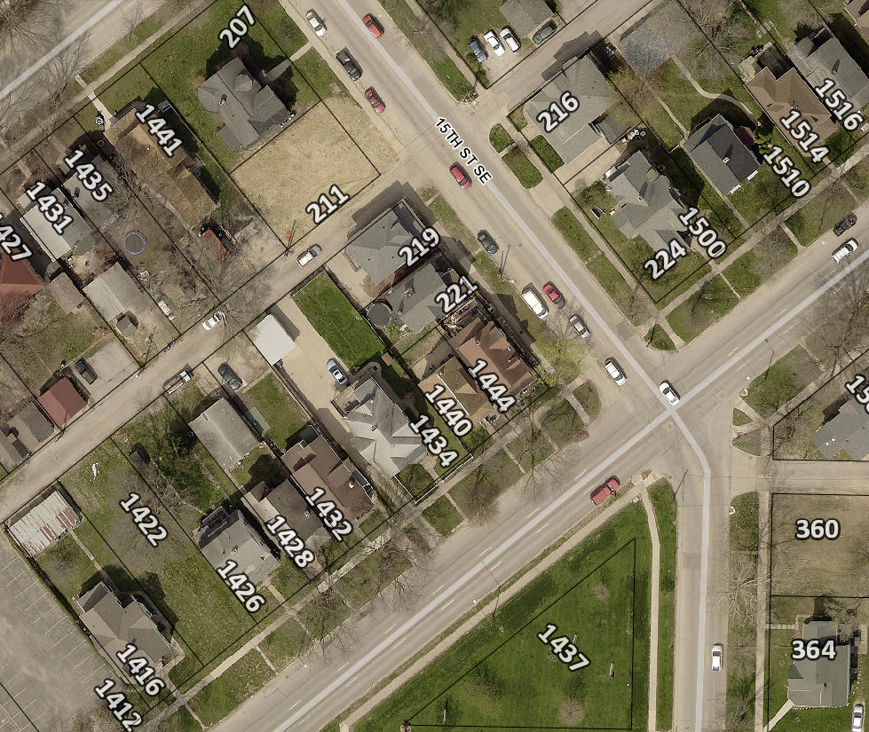
Project Description
Replace decking, railing and steps on existing porch.
Constructed in 1900
Contributing structure to the 2nd and 3rd Ave District.

Slide 8
221 15th St SE
Photograph from 1995

Slide 9
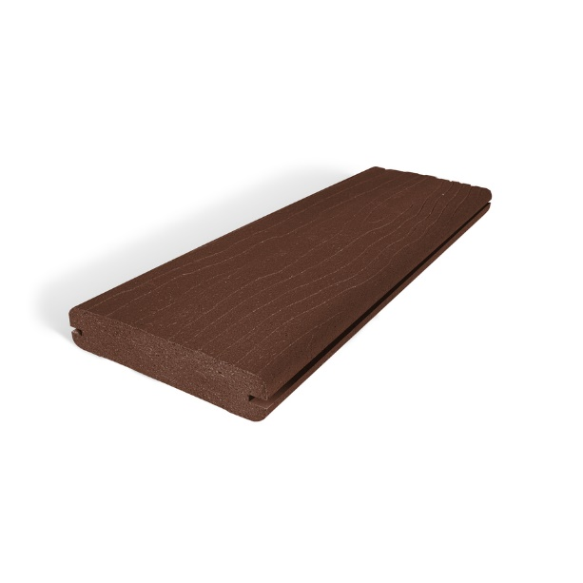
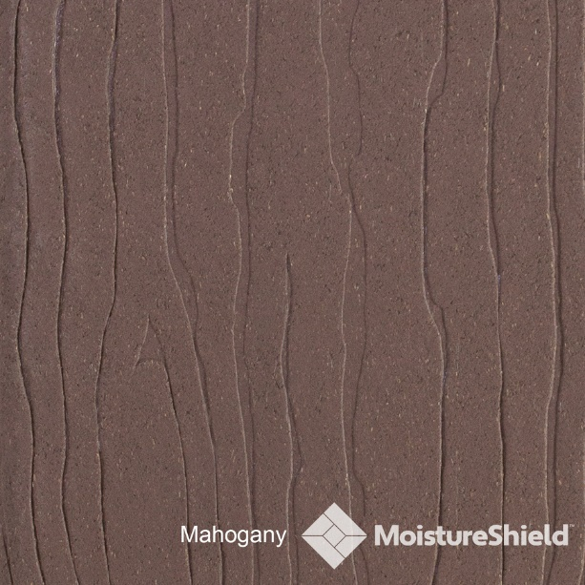
Materials
Composite decking
Wood plastic composite covered with a PVC skin.

Slide 10
Historic District Guidelines - Porches and Other Entrances
Recommended:
Opening an enclosed porch
Repairing the existing porch or balcony
Replacing wood elements (wood elements should be painted)
Replacing masonry elements with masonry elements
Rebuilding a porch with original materials
Screening
Painted, not treated wood
Not Recommended:
Enclosing porches visible from the street
Modern straight-edged railings
Columns made of modern materials (fiberglass for an example)
Plywood panel flooring on entrances facing the street
Carpeted flooring on entrances facing the street
Concrete steps that are visible from the street
Unpainted treated lumber elements (recommended for hidden supports)

Slide 11
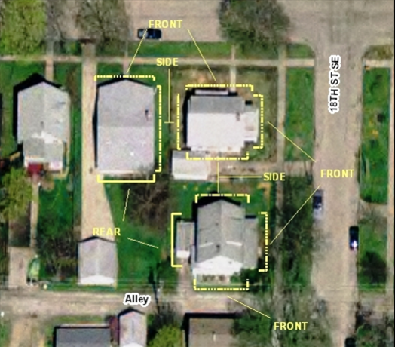
Guideline Prioritization
Those features that face the street or face the alley where it intersects the street. Buildings on corner lots, lots which are located at the intersection of two streets, or at the intersection of a street and an alley, are considered to have two street faces.
Features on sides of buildings that are visible from the street but don’t directly face the street.
Other exterior features not in direct view from the street such as at the rear of buildings.

Slide 12
Criteria for Decision
If any defining features of the building or structure as indicated, but not limited to those included on the Site Inventory Form(s) are proposed to be modified as a result of the proposal indicated on the application for Certificate.
If the proposal is consistent with the Guidelines for Cedar Rapids Historic Districts and/or the most recent edition of the Secretary of Interior's Standards for Rehabilitating Historic Buildings.
If the proposal mitigates adverse effects on the aesthetic, historic, or architectural significance of either the building or structure or of the local historic district or local historic landmark.

Slide 13
Recommendation
Staff recommends approval of project
Contributes to the livability and functionality of the home;
Not the original front porch to the home;
Maintenance-friendly building materials

Slide 14
Actions
Approve as submitted; or
Approve with modifications agreeable to the applicant; or
Deny the application; or
Request additional information.

Slide 16
347 18th St SE
Certificate of Appropriateness

Slide 17
Project Description
Constructed in 1915
Addition of a chain link fence between the garage and house. As well as on the north side property line.
Contributing structure to the Redmond Grande Historic District

Slide 18
347 18th St SE

Slide 19
347 18th St SE

Slide 20
347 18th St SE

Slide 21
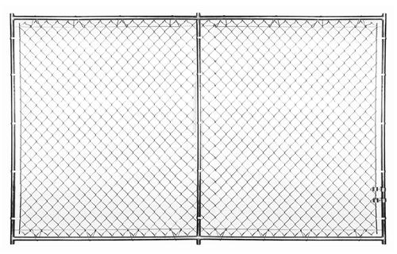
Materials
Approximately 50 ft. total length of 4 ft. chain link fencing

Slide 22
Fences Guidelines
Recommended:
Wooden picket fence
Opaque privacy fence
Maximum of 6 feet high in the rear and side yards
Maximum of 3 feet high in the front yards
Not Recommended:
Chain link fence
Metal fence

Slide 23
Guideline Prioritization
Those features that face the street or face the alley where it intersects the street. Buildings on corner lots, lots which are located at the intersection of two streets, or at the intersection of a street and an alley, are considered to have two street faces.
Features on sides of buildings that are visible from the street but don’t directly face the street.
Other exterior features not in direct view from the street such as at the rear of buildings.

Slide 24
Criteria for Decision
If any defining features of the building or structure as indicated, but not limited to those included on the Site Inventory Form(s) are proposed to be modified as a result of the proposal indicated on the application for Certificate.
If the proposal is consistent with the Guidelines for Cedar Rapids Historic Districts and/or the most recent edition of the Secretary of Interior's Standards for Rehabilitating Historic Buildings.
If the proposal mitigates adverse effects on the aesthetic, historic, or architectural significance of either the building or structure or of the local historic district or local historic landmark.

Slide 25
Recommendation
Staff recommends approval of the project
Location of project affords the commission the most flexibility
Project is mitigated by the close proximity of adjacent home.

Slide 26
Actions
Approve as submitted; or
Approve with modifications agreeable to the applicant; or
Deny the application; or
Request additional information.

Slide 28
1812 2nd Ave SW
Certificate of Appropriatness

Slide 29
Project Description
Residential structure constructed in 1910
Installing 190 ft. of fencing in the back yard area and across driveway towards rear of the house
Installing a gate system(s)
The home contributes to the 2nd and 3rd Avenue Historic District and is individually eligible for the National Register of Historic Places

Slide 30
1812 2nd Ave SW

Slide 31
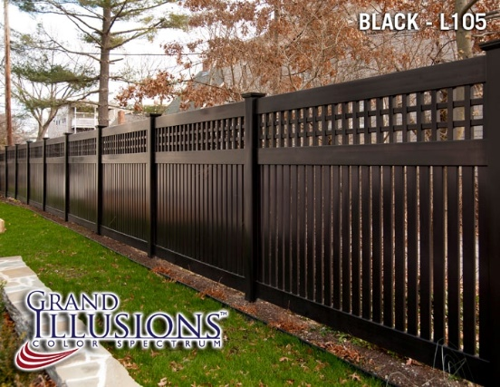
Materials
Vinyl semi-privacy fence and driveway gate
English lattice on top and 3” boards below
Craftsman style fence
Wood grain, flat finish with no gloss or reflection

Slide 32
Fence Design Guidelines
Recommended
Not Recommended
Wooden picket fence
Opaque privacy fence
Maximum of 6 feet high in the rear and side yards
Maximum of 3 feet high in the front yards
Chain link fence
Metal fence

Slide 33
Guideline Prioritization
Those features that face the street or face the alley where it intersects the street. Buildings on corner lots, lots which are located at the intersection of two streets, or at the intersection of a street and an alley, are considered to have two street faces.
Features on sides of buildings that are visible from the street but don’t directly face the street.
Other exterior features not in direct view from the street such as at the rear of buildings.

Slide 34
Criteria for Decision
If any defining features of the building or structure as indicated, but not limited to those included on the Site Inventory Form(s) are proposed to be modified as a result of the proposal indicated on the application for Certificate.
If the proposal is consistent with the Guidelines for Cedar Rapids Historic Districts and/or the most recent edition of the Secretary of Interior's Standards for Rehabilitating Historic Buildings.
If the proposal mitigates adverse effects on the aesthetic, historic, or architectural significance of either the building or structure or of the local historic district or local historic landmark.

Slide 35
Recommendation
Staff recommends approval of the project
The location of the project is in areas that afford the commission the most flexibility in terms of priority
Fence is mitigated by the general proximity of structures as well which is less visible from the right-of-way

Slide 36
Actions
Approve as submitted; or
Approve with modifications agreeable to the applicant; or
Deny the application; or
Request additional information.

Slide 38
1638 3rd Ave SE
Certificate of Appropriateness

Slide 39
Project Description
Construction of a new single-family home with detached accessory structure (garage)
Two story structure
1638 3rd Ave SE

Slide 40
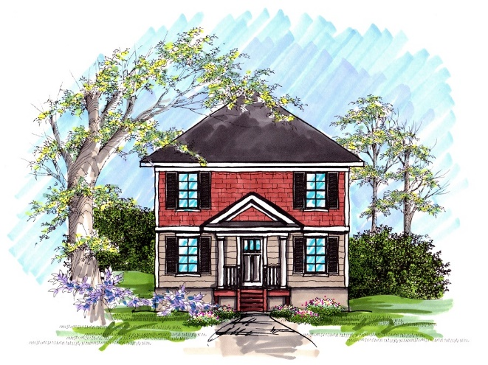
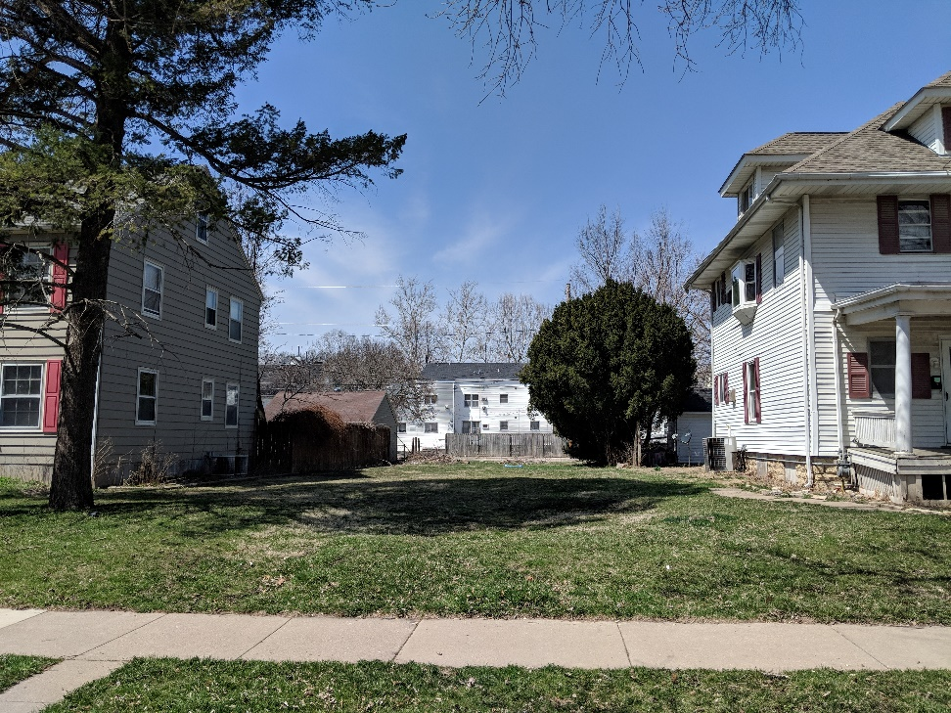
1638 3rd Ave SE

Slide 41
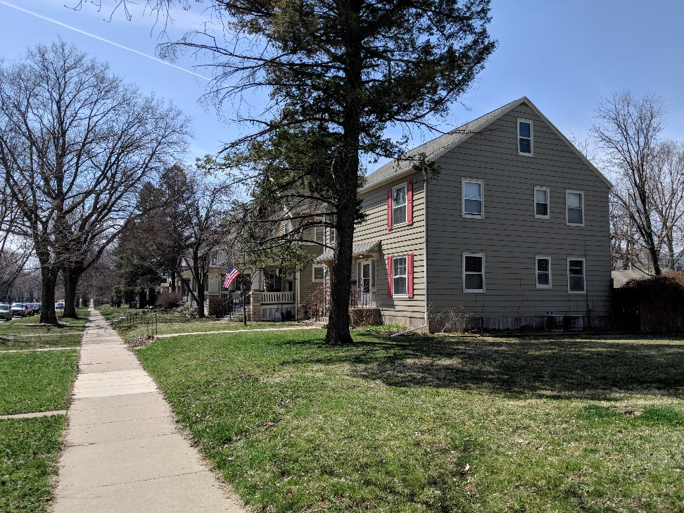
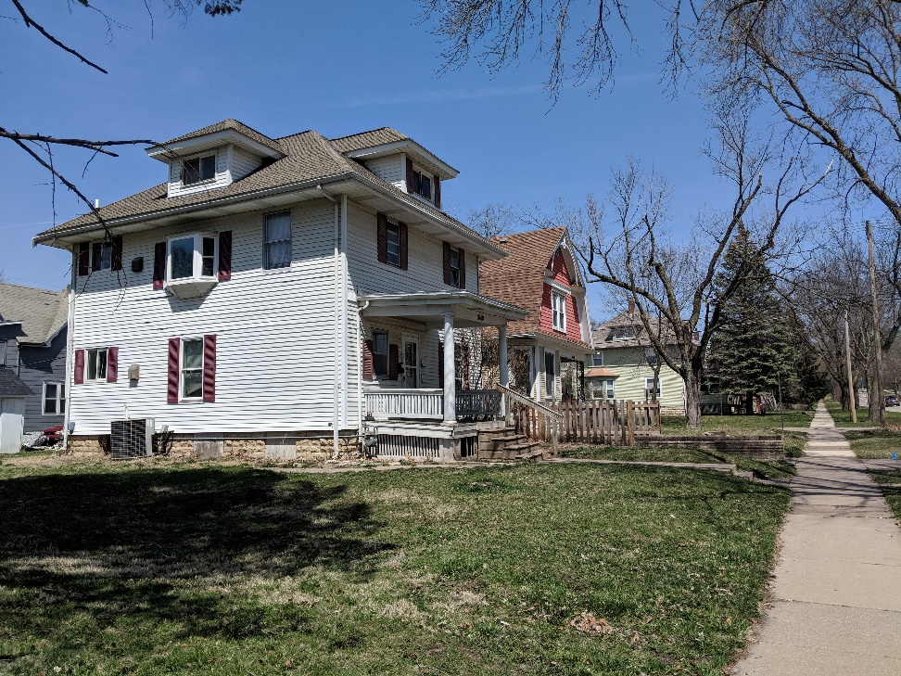
1638 3rd Ave SE

Slide 42
1638 3rd Ave SE

Slide 43
1638 3rd Ave SE

Slide 44
1638 3rd Ave SE

Slide 45
Materials
Wood frame structure
LP Smart Siding
Wood based siding
Premium vinyl windows
Fiberglass front door
Asphalt roof
Matches adjacent properties

Slide 46
Historic District Guidelines Streetscapes
Recommended:
New construction that matches the style of the neighborhood.
Flexibility in contemporary building materials and technologies.
Not Recommended:
Blank facades
Uneven set backs
Contemporary designs
Not retaining components of the original structure (a porch or dormers for example)

Slide 47
SOI Standards for Rehabilitation
“9. New additions, exterior alterations, or related new construction shall not destroy historic materials that characterize the property. The new work shall be differentiated from the old and shall be compatible with the massing, size, scale, and architectural features to protect the historic integrity of the property and its environment.
10. New additions and adjacent or related new construction shall be undertaken in such a manner that if removed in the future, the essential form and integrity of the historic property and its environment would be unimpaired.”

Slide 48
Analysis
Massing, Form, & Site Design:
2 story design
Front porch
Detached garage
Contextual front-yard setback
Consistent with Guidelines: All of these features are similar to adjacent homes and help the home fit into the surrounding historic context.

Slide 49
Analysis
Summary:
Design, form, style, massing, and setbacks match existing neighborhood.
Home does not detract from historical context.
Addresses a gap within an otherwise intact block, which strengthens the historic streetscape
Consistent with SOI standards & Guidelines

Slide 50
Recommendation
Staff recommends approval of project;
Consistent mass, form, setbacks and style with surrounding homes;
Consistent with the intent of the Guidelines and SOI standards;
Consistent with the City’s Comprehensive Plan

Slide 51
Actions
Approve as submitted; or
Approve with modifications agreeable to the applicant; or
Deny the application; or
Request additional information.

Slide 53
2435 Bever Ave SE
Demolition Review

Slide 54
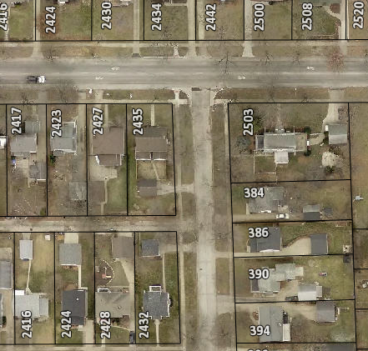
2435 Bever Ave SE
Accessory structure built in 1920
Within area recommended for intensive survey
Cedar Rapids Citywide Historic and Architectural Reconnaissance Survey
Immediate release

Slide 55
2435 Bever Ave SE

Slide 56
2435 Bever Ave SE

Slide 57
2435 Bever Ave SE
Accessory structure in poor condition
Area is recommended for intensive survey
No current survey property information

Slide 58
1. Determination of Historic Significance
2a. Not Historically Significant
2b. Historically Significant
Release Property
60-day hold if HPC wishes to explore options (e.g. photo doc) with property owner
Release property if HPC does not wish to explore options

Slide 59
18.02(T) Cedar Rapids Municipal Code – Historic Significance:
1. Associated with events that have made a significant contribution to the broad patterns of our history; or
2. Associated with the lives of significant persons in our past; or
3. Embodies the distinctive characteristics of a type, period, or method of construction, or represents the work of a master, or possesses high artistic values, or represents a significant and distinguishable entity whose components may lack individual distinction; or
4. Yielded, or may be likely to yield, information important in history or prehistory.

Slide 60
2218 1st Ave NE
Demolition Review

Slide 61
2218 1st Ave NE
Structure built in 1916
Property not recommended for area of intensive study
Cedar Rapids Citywide Historic and Architectural Reconnaissance Survey
Immediate release

Slide 62
2218 1st Ave NE

Slide 63
2218 1st Ave NE
Structure in below normal condition as per city assessor.
Poor candidate for local land-marking
No city commissioned data to support historic significance designation

Slide 64
1. Determination of Historic Significance
2a. Not Historically Significant
2b. Historically Significant
Release Property
60-day hold if HPC wishes to explore options (e.g. photo doc) with property owner
Release property if HPC does not wish to explore options

Slide 65
18.02(T) Cedar Rapids Municipal Code – Historic Significance:
1. Associated with events that have made a significant contribution to the broad patterns of our history; or
2. Associated with the lives of significant persons in our past; or
3. Embodies the distinctive characteristics of a type, period, or method of construction, or represents the work of a master, or possesses high artistic values, or represents a significant and distinguishable entity whose components may lack individual distinction; or
4. Yielded, or may be likely to yield, information important in history or prehistory.

Slide 67
203 16th Ave SE
Façade Structure Modification Review

Slide 68
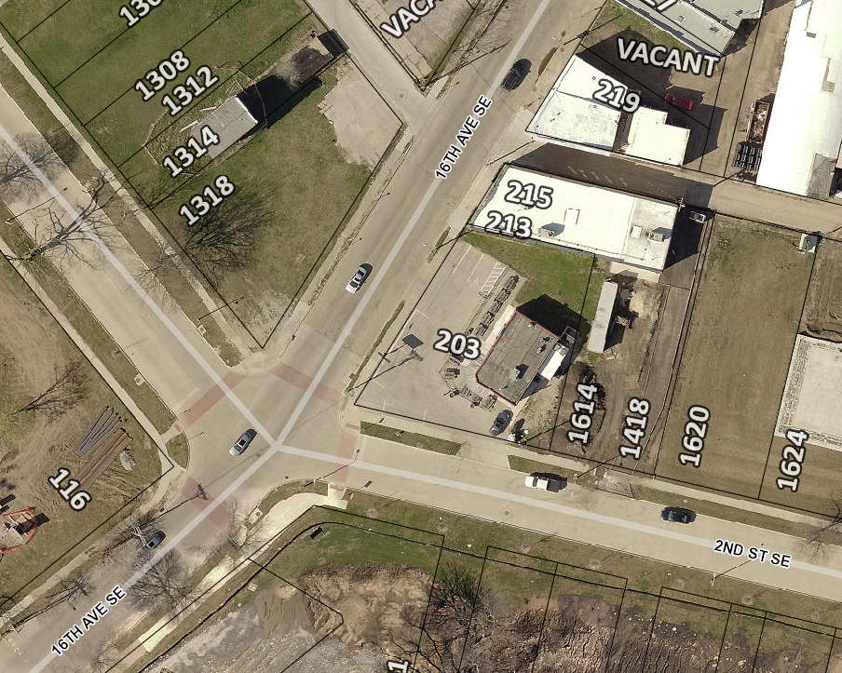
Project Description
Kickstand Bar
Single-story commercial building built in 1959
Addition of prep/storage area
Addition of outdoor bar
Addition of public restrooms
Located in the Bohemian Commercial Historic District

Slide 69
203 16th Ave SE

Slide 71
203 16th Ave SE
Restaurant in “excellent” condition as per the City Assessor
The 2002 National Register Nomination for the Bohemian Commercial Historic District deemed this property non-contributing to the integrity of the historic district
Immediate Release

Slide 72
1. Determination of Historic Significance
2a. Not Historically Significant
2b. Historically Significant
Release Property
60-day hold if HPC wishes to explore options (e.g. photo doc) with property owner
Release property if HPC does not wish to explore options

Slide 73
18.02(T) Cedar Rapids Municipal Code – Historic Significance:
Associated with events that have made a significant contribution to the broad patterns of our history; or
Associated with the lives of significant persons in our past; or
Embodies the distinctive characteristics of a type, period, or method of construction, or represents the work of a master, or possesses high artistic values, or represents a significant and distinguishable entity whose components may lack individual distinction; or
Yielded, or may be likely to yield, information important in history or prehistory.

Slide 74
Historic Preservation Commission
Staff Liaison:
Iván Gonzalez
Planner
i.gonzalez@cedar-rapids.org
319.286.5428
William Micheel
Comm. Dev. Assistant Director
w.micheel@cedar-rapids.org
319.286.5045

