Slide 1
Historic Preservation Commission
August 23, 2018

Slide 2
Mt. Vernon Road Paving for Progress Project Update
Presentation

Slide 3
Mt. Vernon Road Paving for Progress Project Update
Paving for Progress is a Local Option Sales Tax of 1% used exclusively for street maintenance, repair, construction, and reconstruction projects
Generates approximately $18 Million per year and $200 Million over life of the program
Program life is from 2014 – 2024

Slide 4
Mt. Vernon Road Paving for Progress Project Update
Corridor Action Plan adopted 1/24/17
Recommends improvements for Mt. Vernon Road including the intersections at 19th Street SE and 15th Street SE
Coordinated with Paving for Progress

Slide 5
Mt. Vernon Road Paving for Progress Project Update

Slide 6
Mt. Vernon Road Paving for Progress Project Update

Slide 7
Mt. Vernon Road Paving for Progress Project Update

Slide 8
Mt. Vernon Road Paving for Progress Project Update

Slide 9
Mt. Vernon Road Paving for Progress Project Update

Slide 10
Mt. Vernon Road Paving for Progress Project Update

Slide 11
Local Historic District Nomination Process
Presentation

Slide 12
Local Historic District Nomination Process
Can be initiated by HPC, City Council, or by any person/organization/entity by filling out application
Application materials must include:
Narrative on historic significance
Map with exact boundaries of proposed district
Inventory of the historic structures and sites
List of owners in the proposed district

Slide 13
Local Historic District Nomination Process
Application materials must include:
Petition with 60% of total number of parcels supporting proposed district
Must inform potential signatories about Chapter 18 and the Historic Preservation Guidelines
HPC holds public meeting on the nomination
Published in newspaper, letters sent out to all property owners in proposed district
Recommend approval or denial in writing

Slide 14
Local Historic District Nomination Process
State Historic Preservation Office review
City Planning Commission review
City Council public hearing on ordinance
Districts can be repealed or modified following the same process

Slide 15
Proactive Presentation
Presentation

Slide 16
1730 Park Ave SE
Certificate of Appropriateness

Slide 17
Project Description
Remove and replace front porch, steps, and footing with all like dimensions
Primary structure constructed in 1914
Contributes to the Redmond Park – Grande Ave District and is individually eligible for National Register

Slide 18
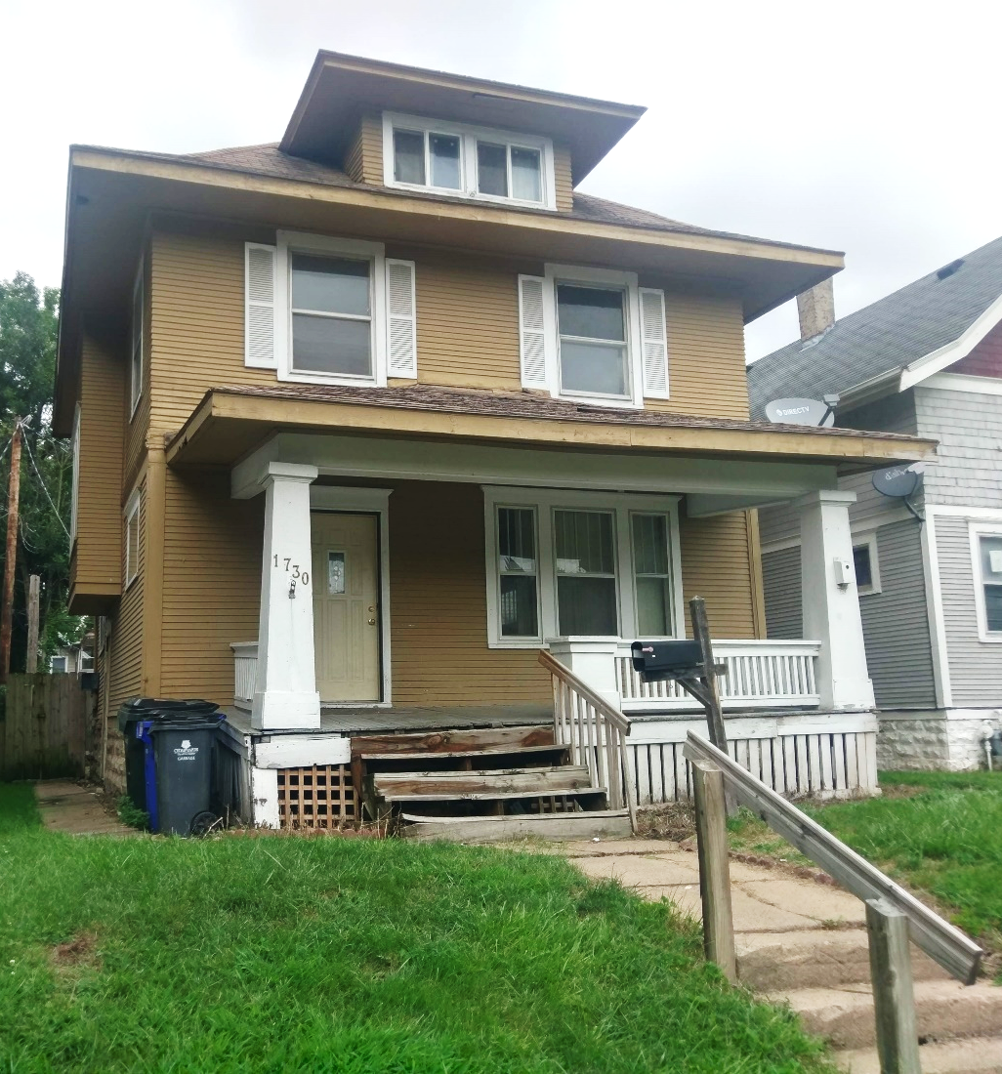
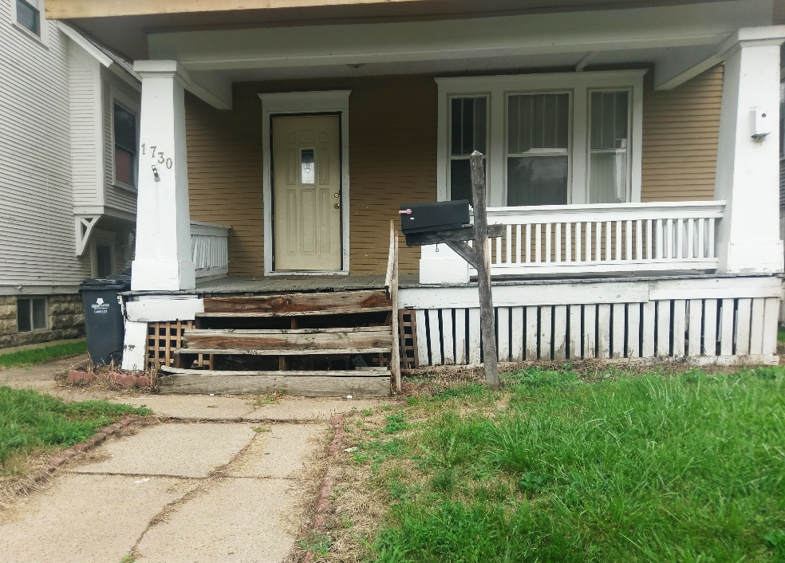
1730 Park Ave SE

Slide 19
Materials
Treated lumber for structure of porch
Will utilize same dimensions as previous porch
Concrete for footings

Slide 20
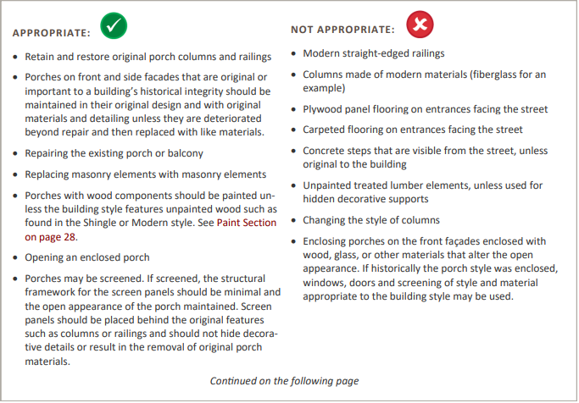
Historic Preservation Guidelines – Porches & Other Entrances

Slide 21
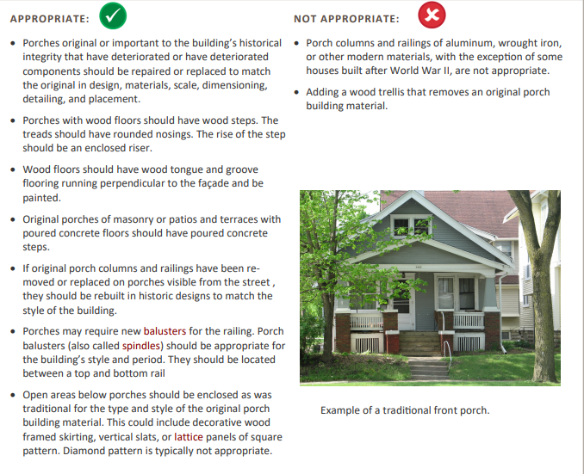

Slide 22
Guideline Prioritization
If compromises must be made for budget reasons, priority should be given to exteriors that can be seen from the street and have the most impact on the streetscape.
For example, retaining a front porch would have higher priority than keeping a back porch or than retaining wood siding on a rear elevation.

Slide 23
Criteria for Decision
If any defining features of the building or structure as indicated, but not limited to those included on the Site Inventory Form(s) are proposed to be modified as a result of the proposal indicated on the application for Certificate.
If the proposal is consistent with the Guidelines for Cedar Rapids Historic Districts and/or the most recent edition of the Secretary of Interior's Standards for Rehabilitating Historic Buildings.
If the proposal mitigates adverse effects on the aesthetic, historic, or architectural significance of either the building or structure or of the local historic district or local historic landmark.

Slide 24
Actions
Recommendation
Deny as submitted
Approve if applicant paints the porch
Approve as submitted; or
Approve with modifications agreeable to the applicant; or
Deny the application; or
Request additional information.

Slide 25
1005 3rd Ave SW
Demolition Review

Slide 26
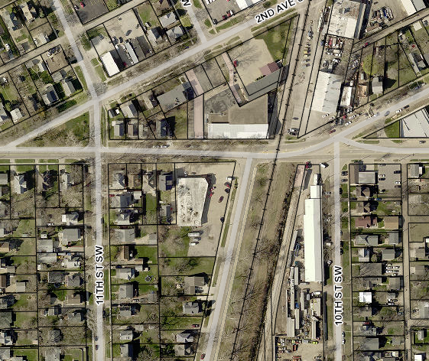
Project Description
Structure for demolition is one-story commercial structure built in 1950.
Not included in a historical or architectural survey
Not recommended for survey

Slide 27
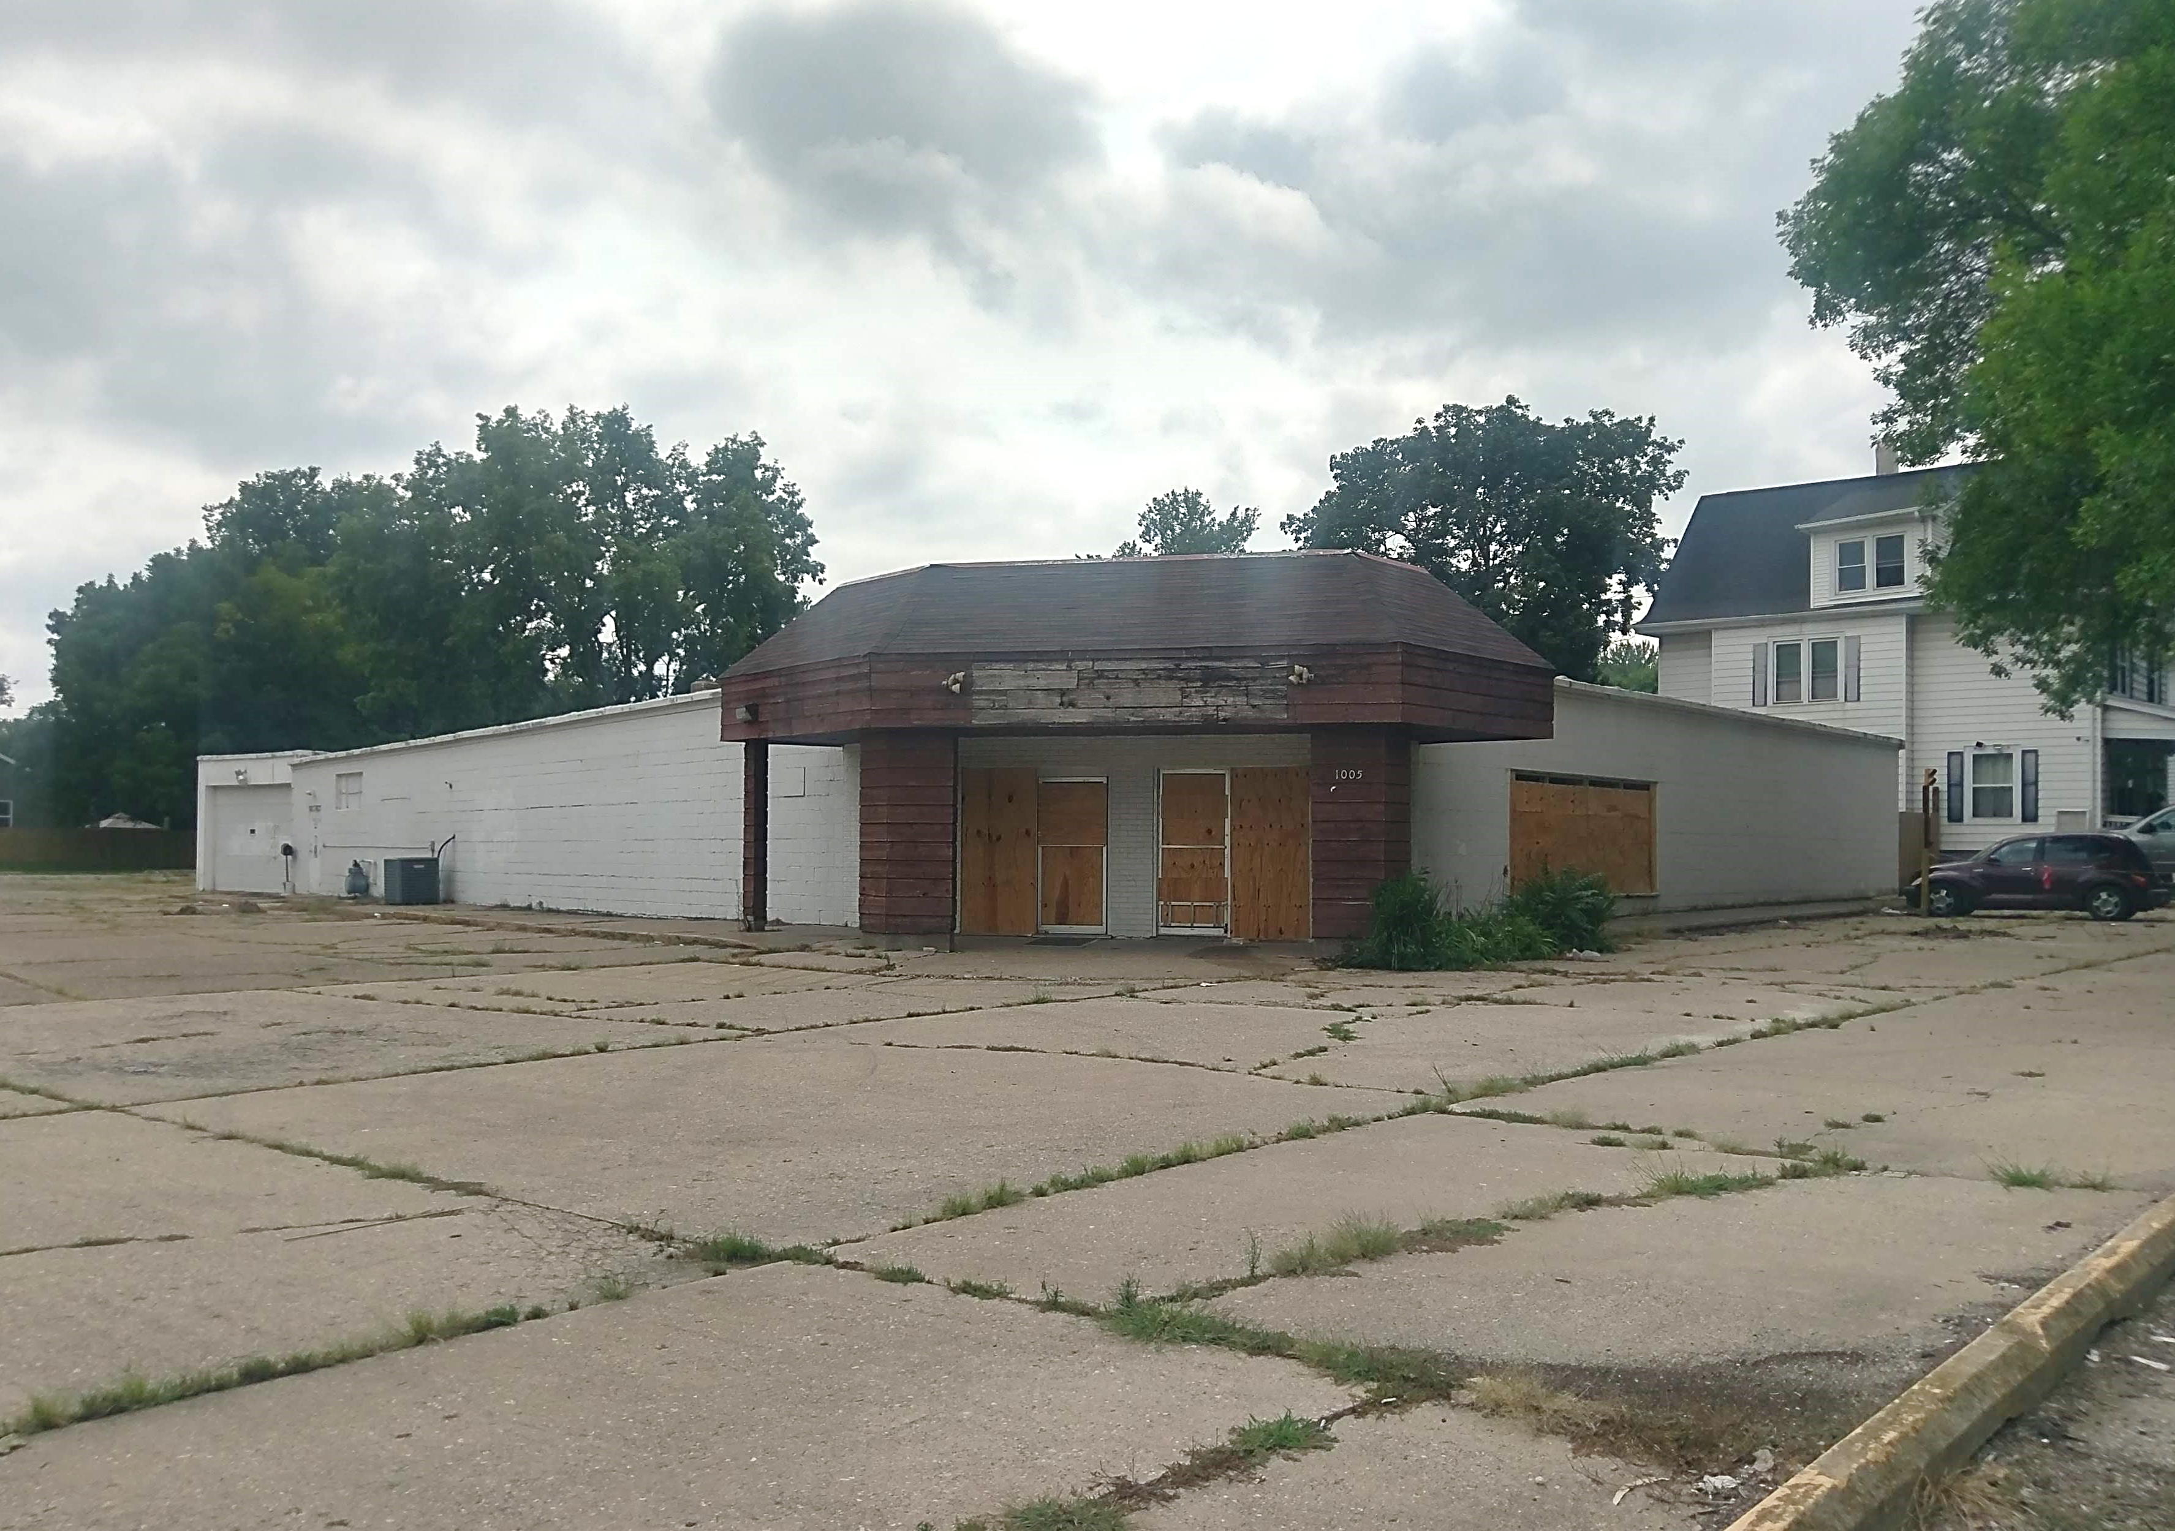
1005 3rd Ave SW

Slide 28
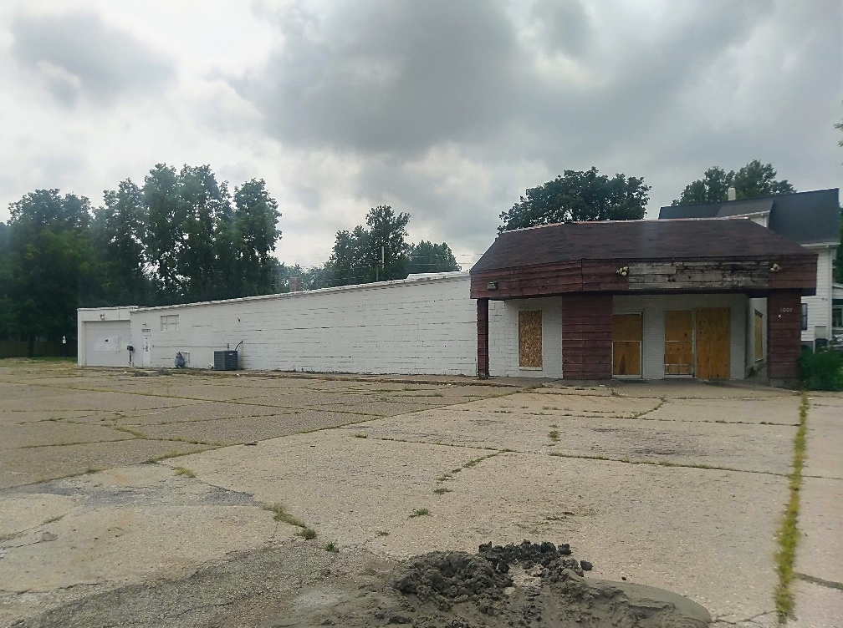
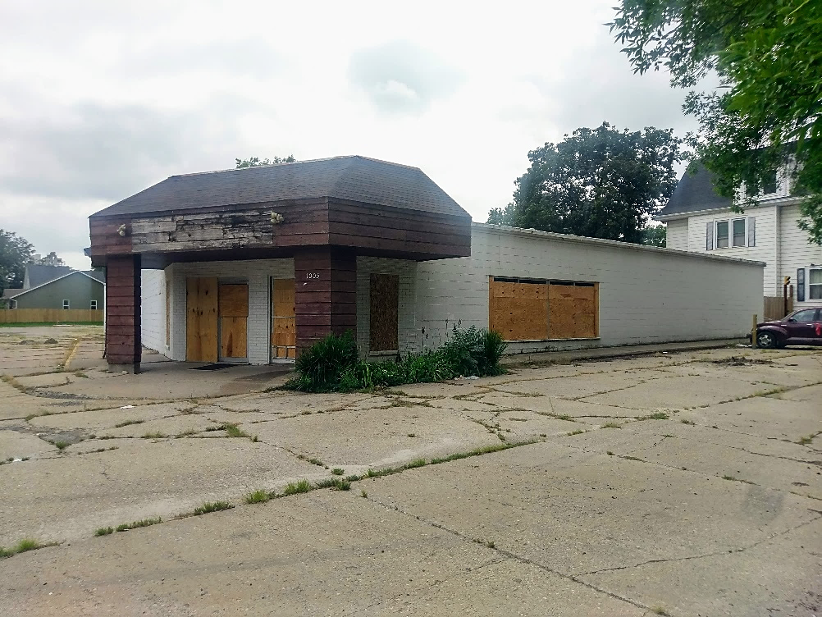
1005 3rd Ave SW

Slide 29
1005 3rd Ave SW
Poor candidate for local land marking
No evidence to corroborate historical significance
Staff recommends immediate release

Slide 30
1. Determination of Historic Significance
2a. Not Historically Significant
2b. Historically Significant
Release Property
60-day hold if HPC wishes to explore options (e.g. photo doc) with property owner
Release property if HPC does not wish to explore options

Slide 31
18.02(T) Cedar Rapids Municipal Code – Historic Significance:
1. Associated with events that have made a significant contribution to the broad patterns of our history; or
2. Associated with the lives of significant persons in our past; or
3. Embodies the distinctive characteristics of a type, period, or method of construction, or represents the work of a master, or possesses high artistic values, or represents a significant and distinguishable entity whose components may lack individual distinction; or
4. Yielded, or may be likely to yield, information important in history or prehistory.

Slide 32
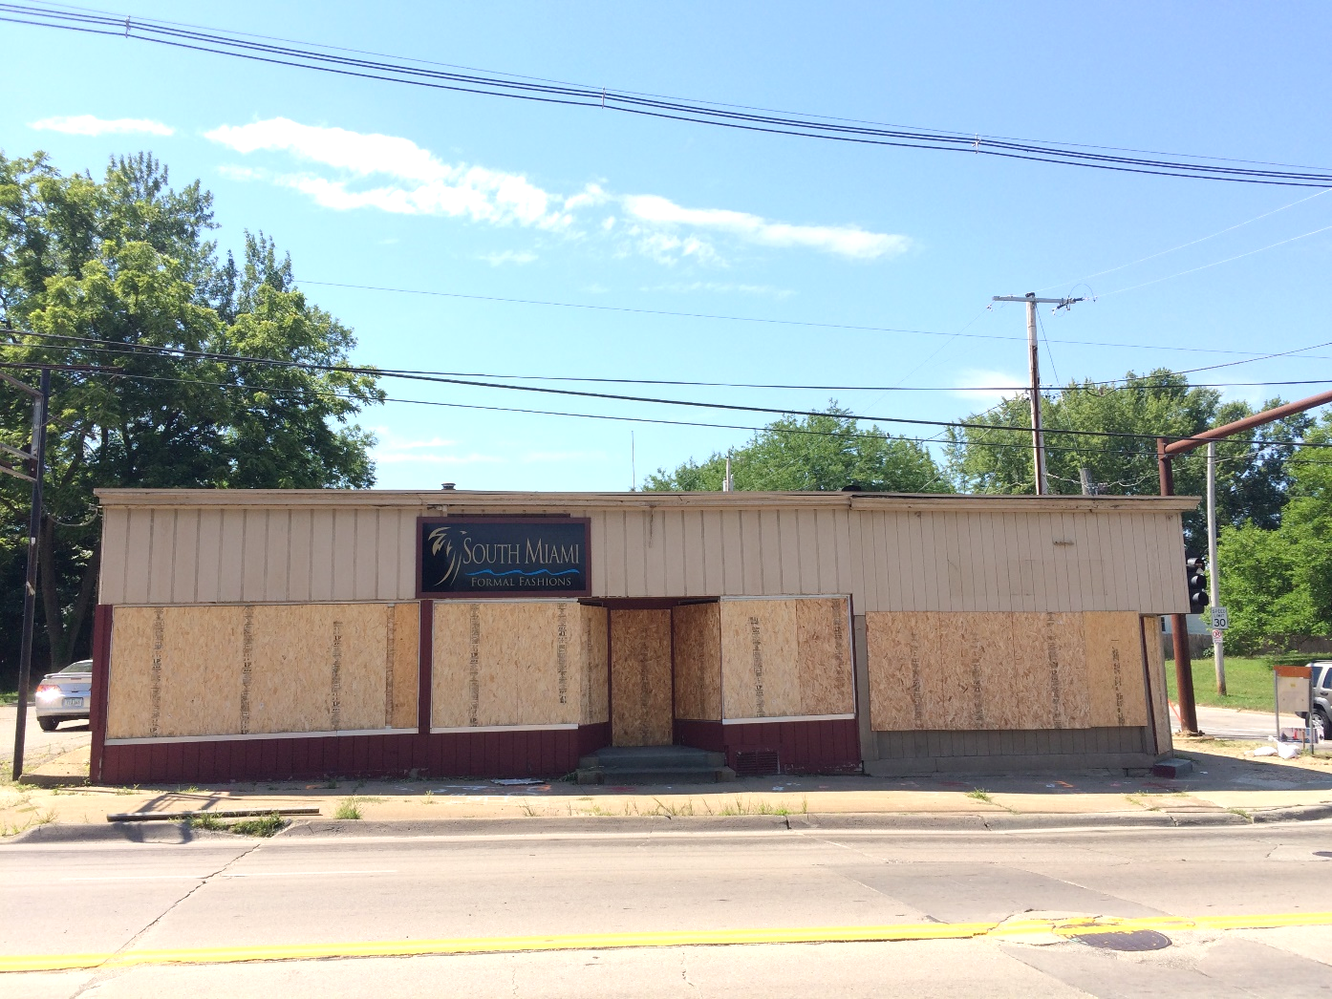
1901 Mt. Vernon Rd. SE – Hold Expires 9/10/18

Slide 33
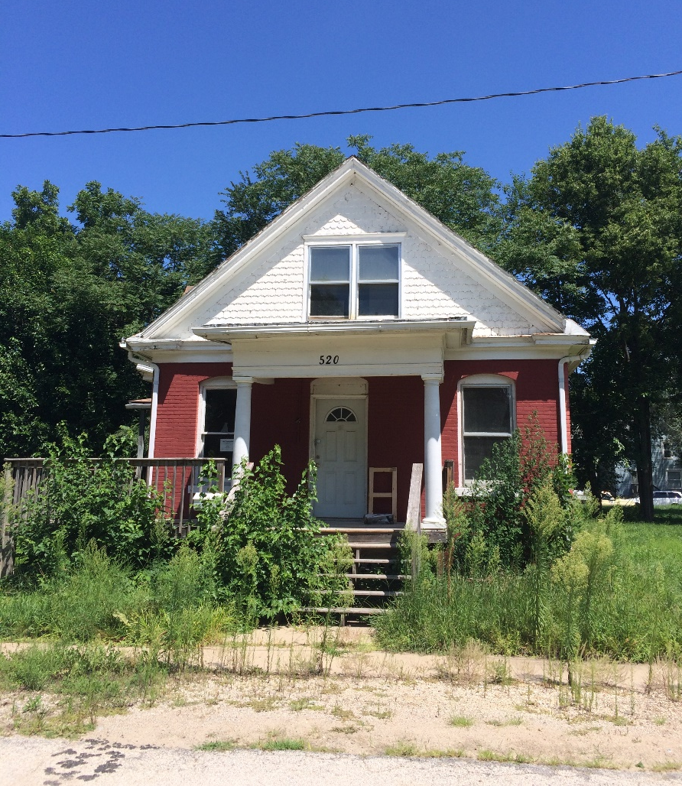
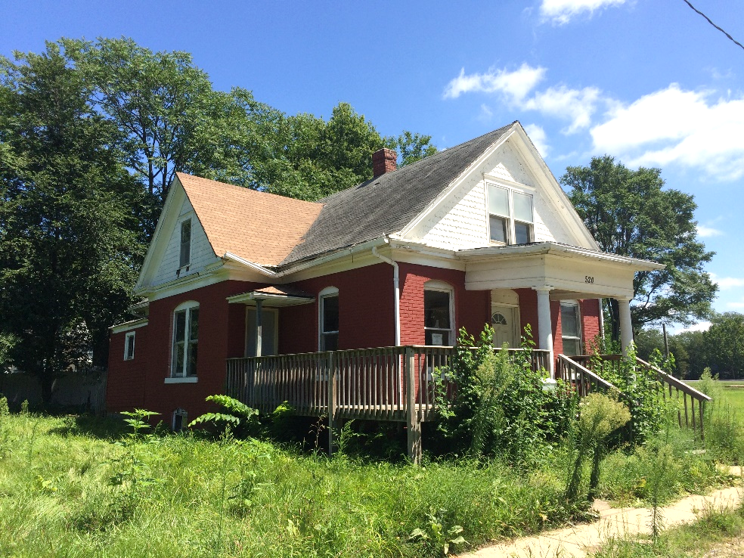
520 Cobban Ct. SE – Hold expires 10/8/18

Slide 34
Historic Preservation Commission
Staff Liaison:
Adam Lindenlaub
Comm. Dev. Planner
a.lindenlaub@cedar-rapids.org
319.286.5064
William Micheel
Comm. Dev. Assistant Director
w.micheel@cedar-rapids.org
319.286.5045

