Slide 1
Visual Arts Commission
August 8, 2019

Slide 2
Agenda
Roll Call
Approval of Minutes – July 11, 2019
Public Input
Updates and Discussion Items
LWV Site Proposal
Pocket Plaza Art
Light Sculpture
Storm Drain Art
3rd St. Sculpture Trail
Member Updates/Announcements
Adjournment

Slide 3
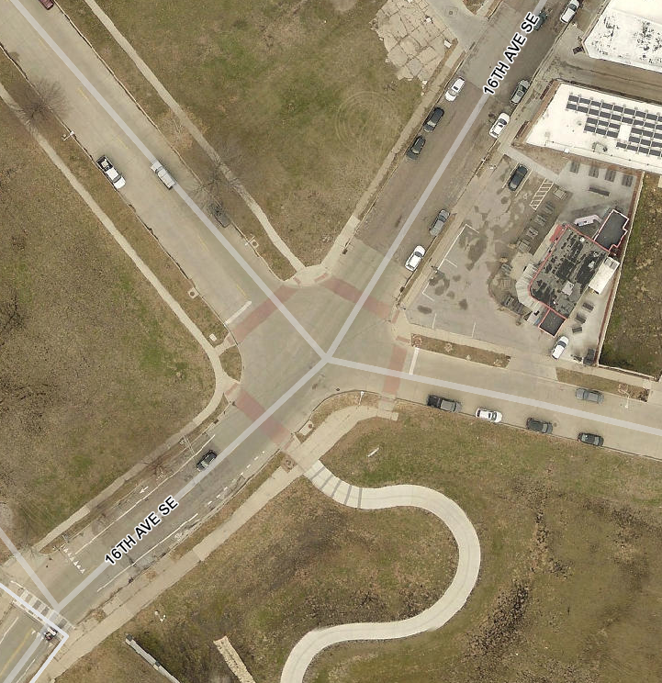
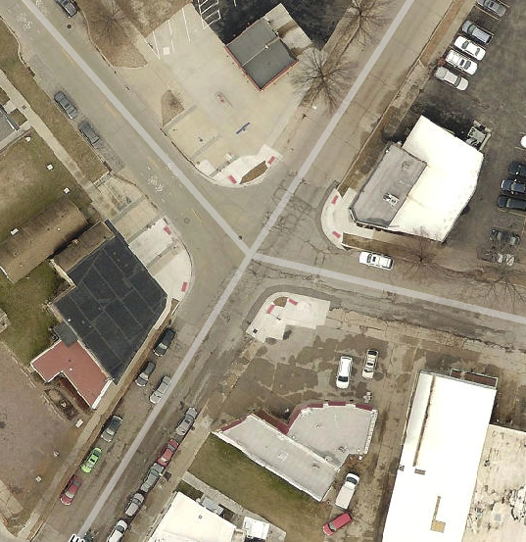
LWV Commemorative Memorial
https://www.google.com/maps/@41.9684478,-91.6579863,272m/data=!3m1!1e3?hl=en

Slide 4
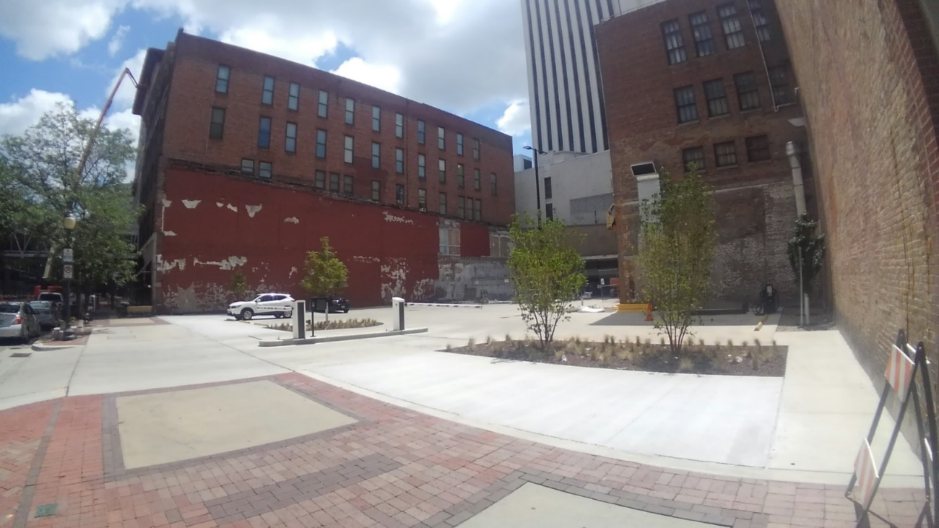
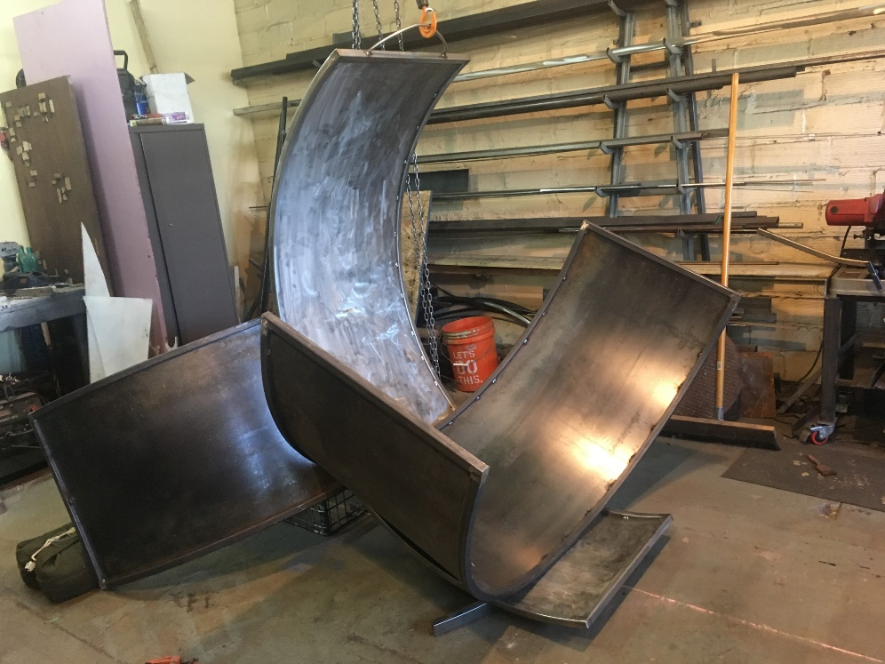
UFG Pocket Plaza Art
Completion date of pocket plaza set for August/early September
Sculpture is complete and ready for installation
Examining options for Mural/Banner Art

Slide 5
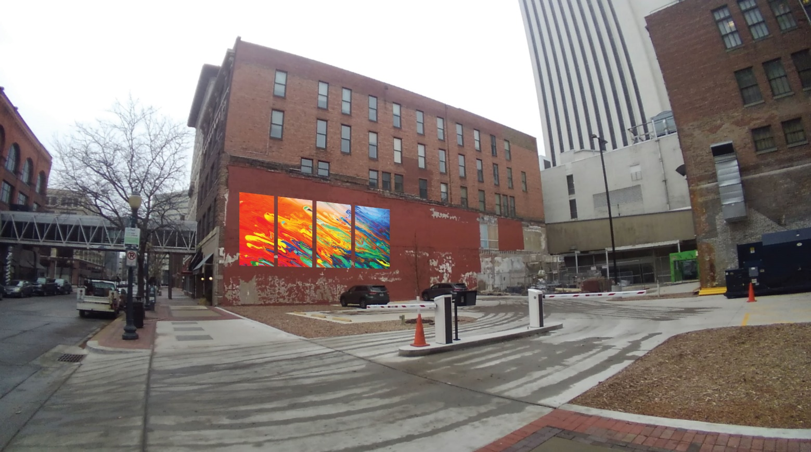
UFG Pocket Plaza Art
$5,200 for production and installation
$4,800 to go towards Artist Fee
Best way to publish artist call?

Slide 6
U.S. Cellular Center Light Sculpture
Application Deadline: 9/5/19
Days Remaining: 28
Received 11 applications to date.
Selection of Finalists: 9/19/19
Proposal Deadline: 11/4/19
Final Selection of Artist: 11/14/19
Artist Meetings 1-3: TBD
Completion and Installation: Summer 2020

Slide 7
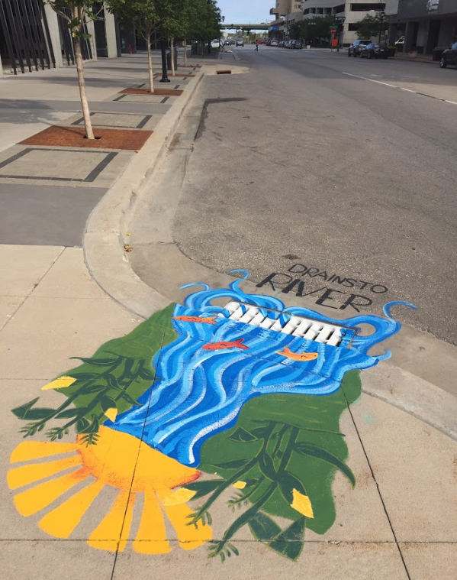
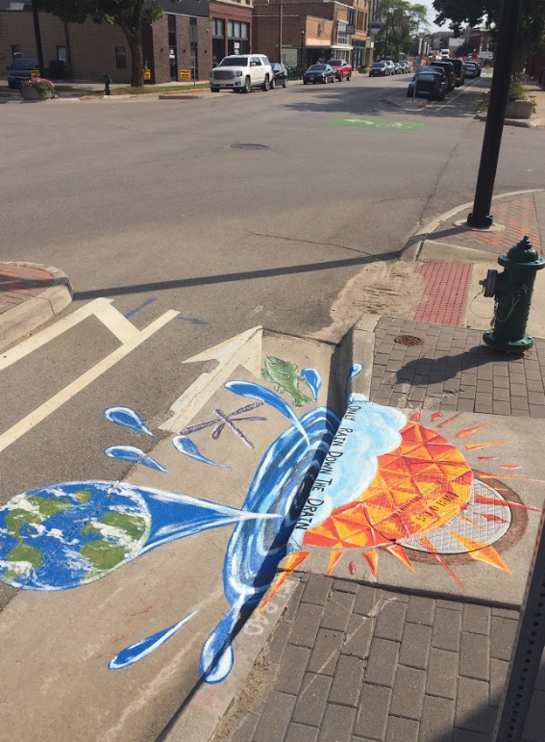
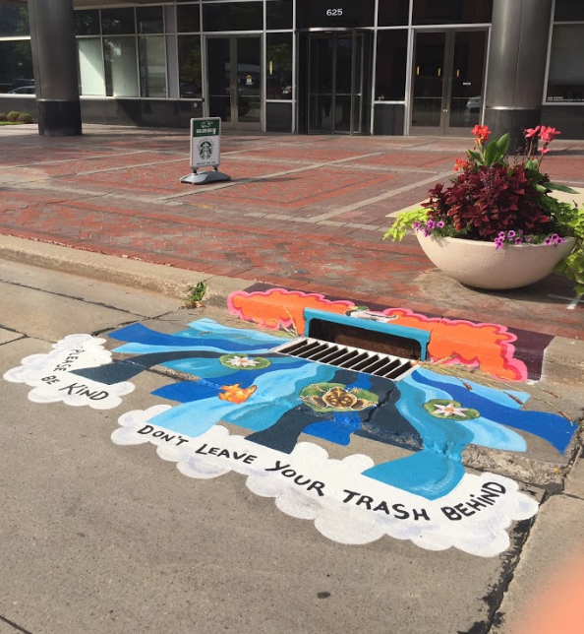
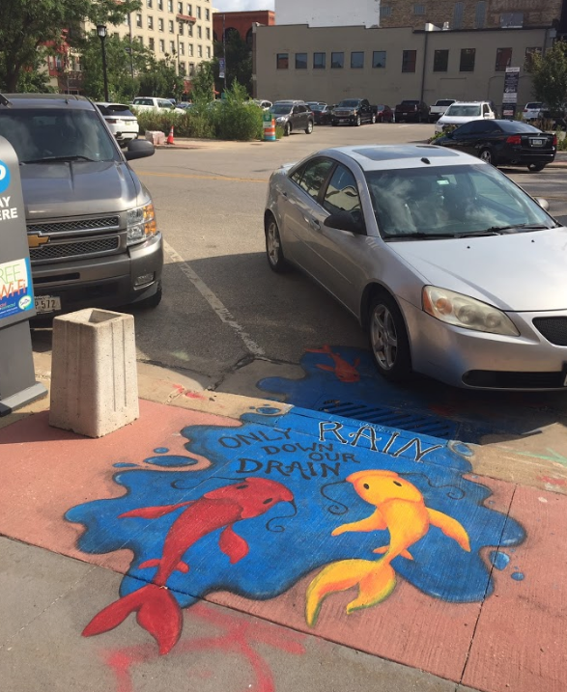
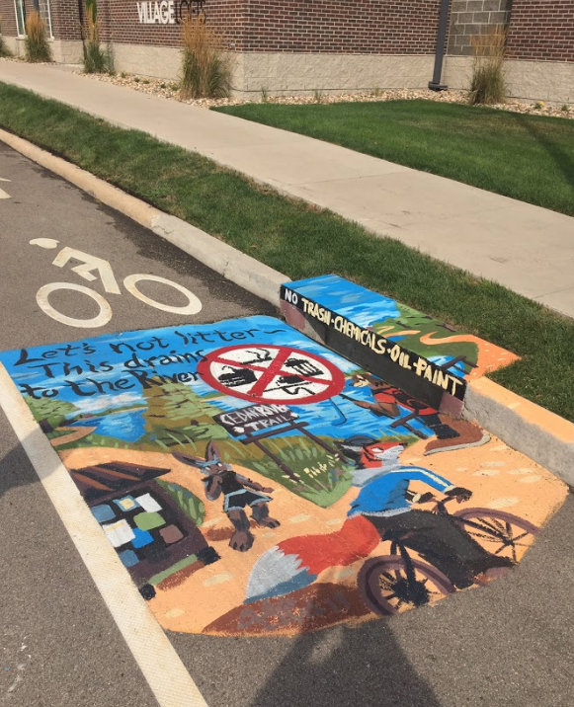
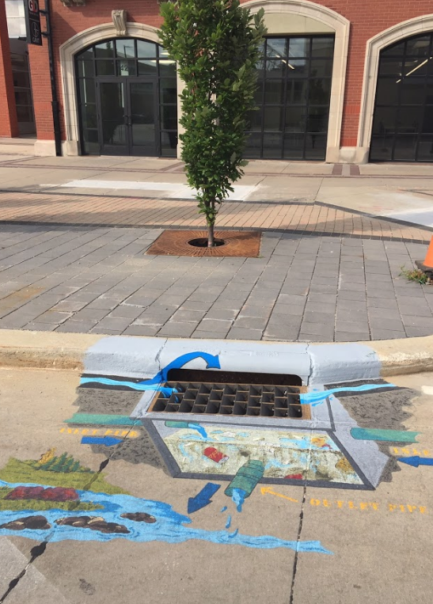
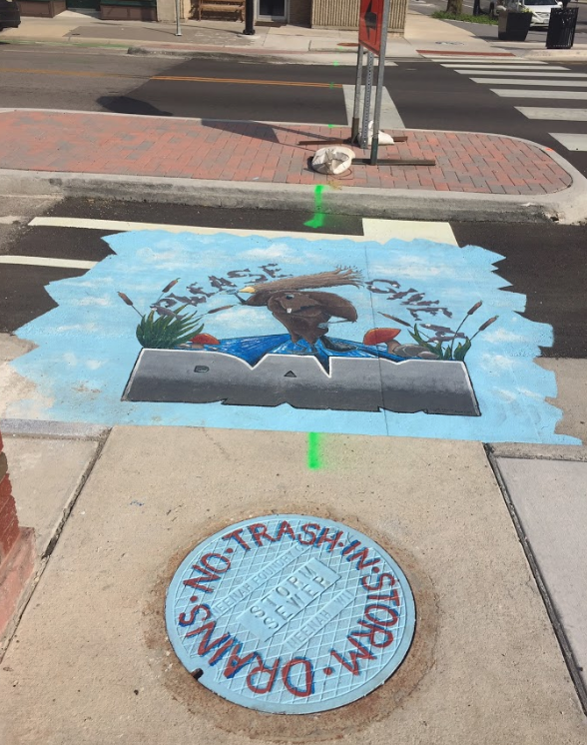
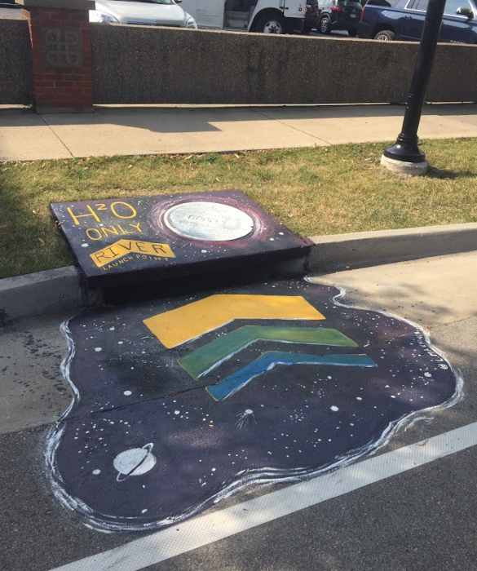
Storm Drain Art

Slide 8
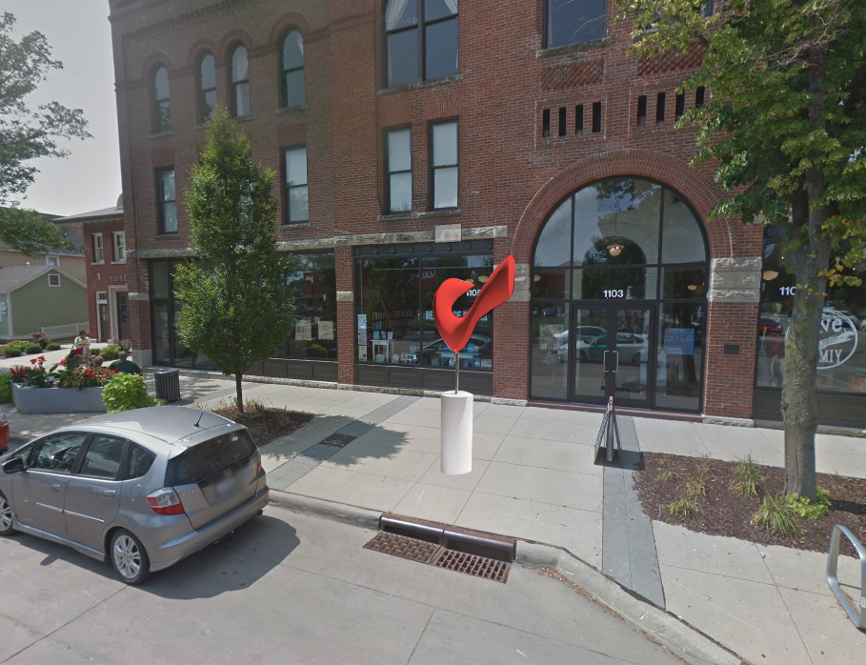
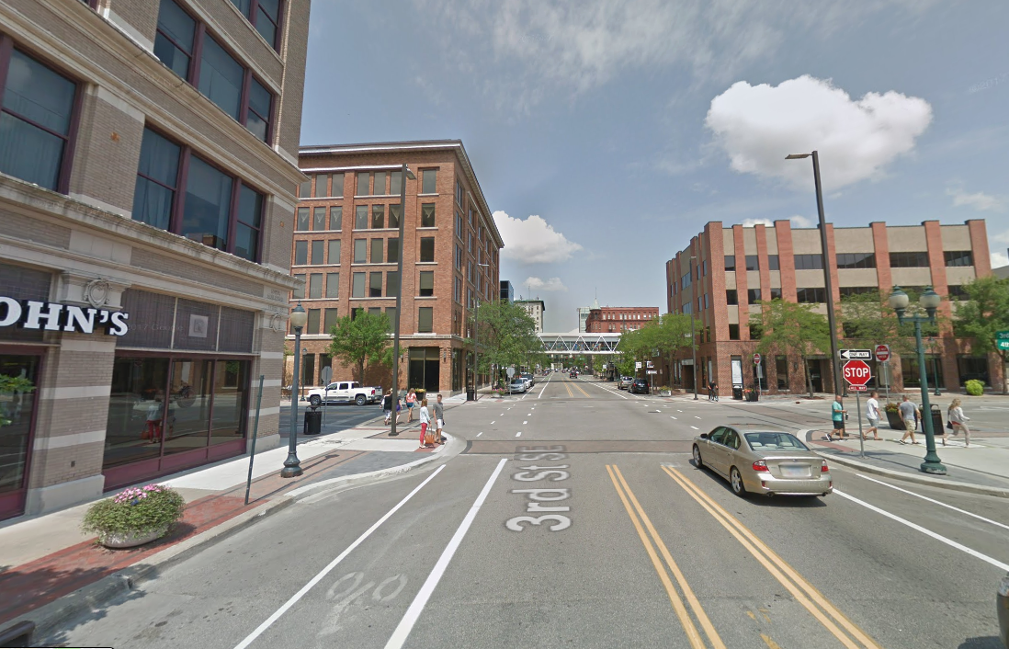
3rd Street Sculpture Trail

Slide 9
6. Member Updates/Announcements
7. Adjournment
Next Meeting: September 19, 2019

